Slide 1
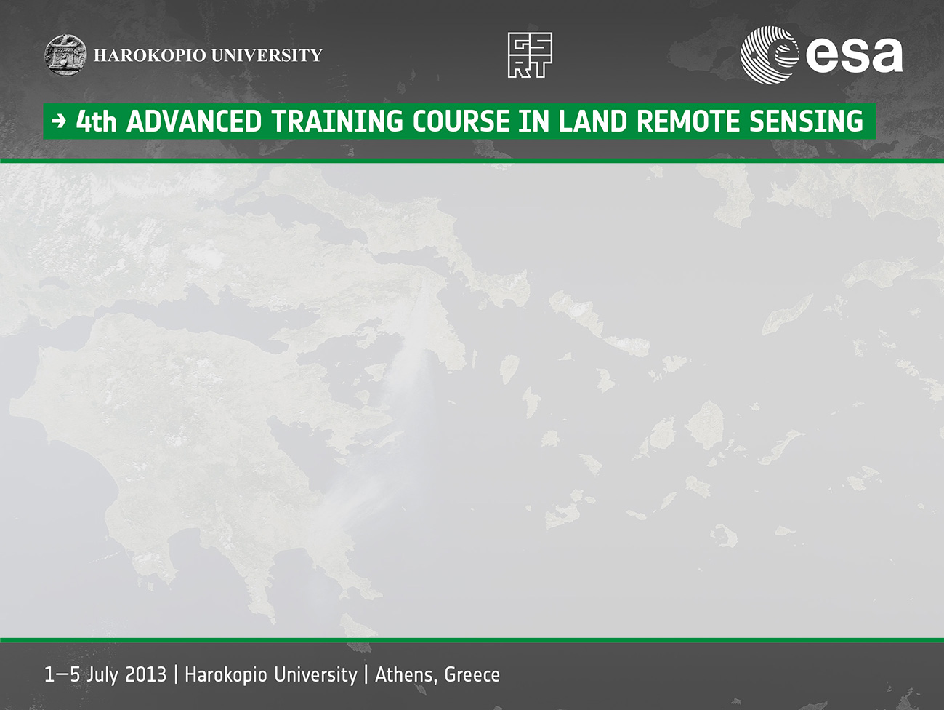

ORFEO ToolBox “is not a black box”
Mickaël Savinaud
mickael.savinaud@orfeo-toolbox.org
"Copyright (c) 2013 by Mickaël Savinaud, CS-SI.
This work is made available under the terms of the Creative Commons Attribution-ShareAlike 3.0 license”.
http://creativecommons.org/licenses/by-sa/3.0/

Slide 2
OUTLINE
Background
Context
History
Free and Open Source Solution
What is OTB ?
OTB uses cases
Conclusion

Slide 3
OTB BACKGROUND
Once upon a time, at CNES

Slide 4


Orfeo ToolBox - Context
ORFEO: Optical and Radar Federated Earth Observation:
Dual Earth observation satellite system:
Optic : CNES, France (Pléiades) / Radar : ASI, Italy (Cosmo-Skymed)
ORFEO Accompaniment Program [1]:
Goals : make easier the development of new algorithms, their validation and capitalization, fill the gap between researchers and ORFEO users.
Thematic part: User’s needs (extracted information) / Product definition / Validation.
Methodological part : Coordination of research activities in Image Processing
Solution: A Generic Image Processing Toolbox
Orfeo ToolBox (OTB) [2]:
Designed to prepare, support and promote the use of remote sensing images
Make the development of new algorithms and their validation easier
Open source software for image processing labs, users and the industry
www.orfeo-toolbox.org

Slide 5

A bit of History
2006 – Everything begins:
Started in 2006 by CNES (French Space Agency), funding several full-time developers (CSSI)
Targeted high resolution images and some applications to other sensors
2009 – Monteverdi: the front end of OTB
from research to end users use case
Provide a capacity building tool
2010 – Venµs L2/L3 processing chain:
from research to operational use case
2011 – Moving towards user friendly applications
Offers the OTB power to end-uses (non programmers): cli and gui interface
Offers the possibility to access at OTB in external software/language: python, QGIS, …
2013 – A new Monteverdi
New visualization framework
Strong interactions with OTB-applications framework

Slide 6
Orfeo ToolBox – A Free and Open Source Software (1/2)
Why choose open source?
To encourage end-users (methodological part) and industry (spatial, GIS) to use the available code
To capitalize the methodological know how : Open research/science
To use an incremental approach to benefit from the results of the methodological research.
Promotes interoperability and best data support
Standard respects
Based on open file formats
Increase security and reliability: code access, strong community
Implementation of popular and strongly used tools
Easy to test and adapt to your needs
Reduce development costs by re-use

Slide 7
Orfeo ToolBox – A Free and Open Source Software (2/2)
OTB license = CeCILL v3
License created by CEA, CNES and INRIA, recognized by FSF
Similar and compatible with GNU GPL
Software with static or dynamic link to OTB must have a CeCILL license (or GNU GPL)
No specific duty to the original authors
No need to make your sources public if you don't distribute the software publicly
License related duty applies if the OTB-based application is diffused outside your organization. You have to:
Copyright respect : indicate which part is modified, indicate license is CeCILL
Keep available the source code for users (who received the piece of software), and only for users
No “license contamination“ of pre-existing software

Slide 8
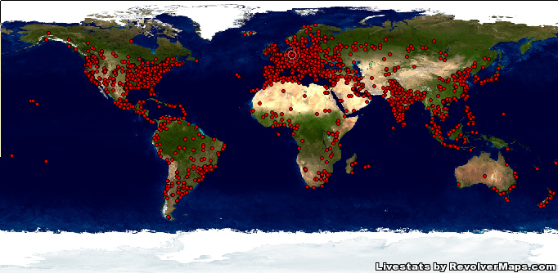
Orfeo ToolBox 2013 – An useful open source image processing tool used by large community

Slide 9
OTB WHAT IS IT ?
It is not a black box

Slide 10
Orfeo ToolBox – An up to date C++ remote sensing library
A large set of algorithms:
Optical/SAR Filtering, Geometry, Change Detection, OBIA, Classification, Segmentation, Feature extraction, Hyperspectral unmixing, Dimensionality reduction, sensor modeling, Stereorectification
Handle large data volume processing
A set of best practices
A front end application: Monteverdi HMI
Some thematic chains are available for users in 2 applications framework
OTB-Applications: built with the OTB classes to address a thematic problem.
OTB Wrappers: share OTB functionalities with external projects.

Slide 11
Orfeo ToolBox – Address various R&D issues
Different research works already done with OTB
in some labs : CESBIO, ENST Bretagne, DLR, … (tool for internship and thesis)
in some research program (EU-FP7, FR-TOSCA):
TOLOMEO [6]:
BIOSOS [7]:
Some R&D studies for ESA and CNES done with OTB
Benchmark the impact of pansharpening methods for Pleiades end-users
Improve automatic image analysis with exogenous data (risk maps, DEM, OpenStreetMap):
How to deal efficiently with large scale segmentation [8]:
SAR interferometry (ESA-SOCIS 2011)
Definition and prototyping of new methods of geometry quality assessment for MTG
ORFEO ToolBox as strong development framework for R&D studies

Slide 12
Orfeo ToolBox - Modularity
Pipeline: Automatic input and output management
Generic programming: use of templates ⇒ opened and evolutive architecture,
Multi platform: daily tested on multiple configurations,
Support of multiple image formats:
classical and remote sensing formats (scalar, complex, mono or multi channels types),
GIS database
Reader
Filter
Writer
File
Image
Image
File

Slide 13
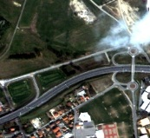
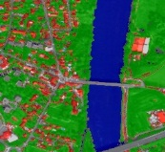
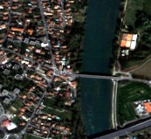
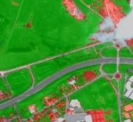
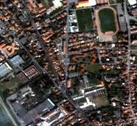
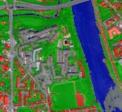
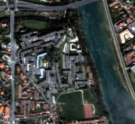
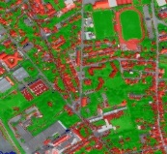
Orfeo ToolBox – Design to support large files processing
Streaming: Process big images by chunks
Control over memory
Seamless and Flexible integration for image processing
Threading: process chunks overs available processors
It is free: all complexity is hidden
Default mode
Support of processing on Pleiades/Quickbird/WorldView2 data for example
Input Image
Output Image
PU1
PU2
PU3
PU4

Slide 14

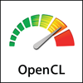




Orfeo ToolBox – A library based on standard tools
OTB-Applications
OTB (Library)
Coming soon
OpenCL
OpenCV
6S/SMAC
LibSVM
Main I/O provider
Raster / Vector/ Database
Base classes
Basic image processing filters
Registration framework
Segmentation
Sensor modeling
Cartographic projection
OpenJPEG
OTB Team contributions

Slide 15



Orfeo ToolBox – From standard tools to end-users
Monteverdi
External systems
QGIS
SEXTANTE Plugin
OTB-Applications
OTB (Library)
Coming soon
Qt
FLTK

Slide 16
Orfeo ToolBox & Best practices: diffusion to external FOSS projects
Contributions to OSSIM:
Strong relations with core developers of OSSIM
Pleiades RPC model
Contributions to OpenJPEG:
Open source support of JPEG2000 format to read Pleiades data
Strong support to the next major release
Goal: offer a robust driver for GDAL and JPEG2000
Strong interactions with QGIS project
Participations to the regular QGIS Hack Fest
Contribution to GSOC project around external project integration => Sextante project
Regular participation to FOSS4G conference

Slide 17
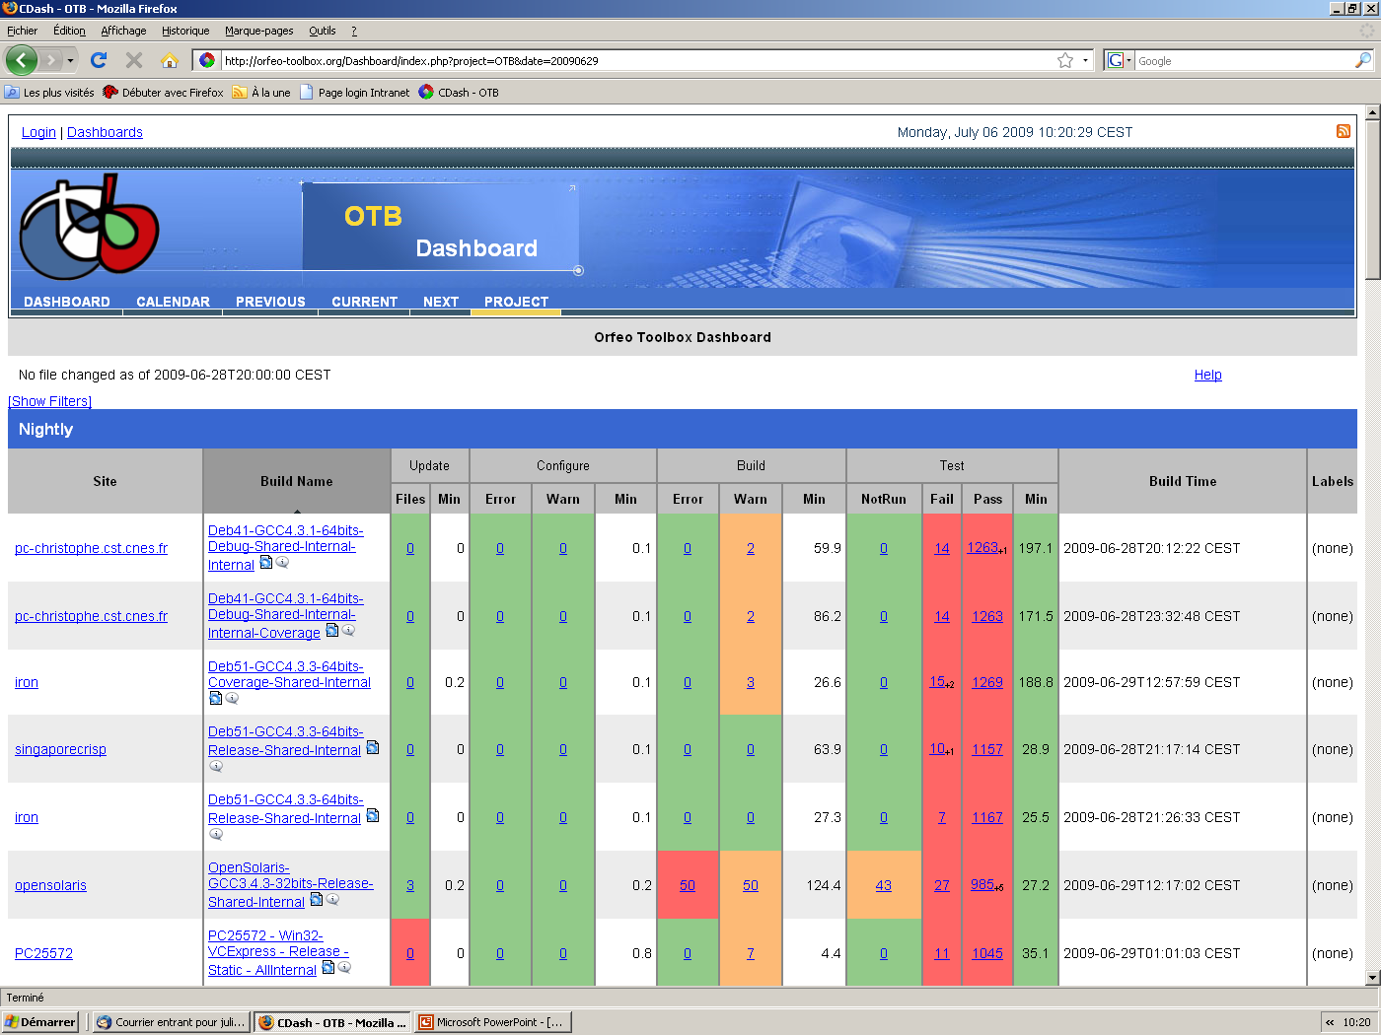
Orfeo ToolBox & Best practices: Maintainability
Test driven development best practices
CMake, CTest, CDash
Continuous integration – Nightly testing: 2500 tests!!

Slide 18
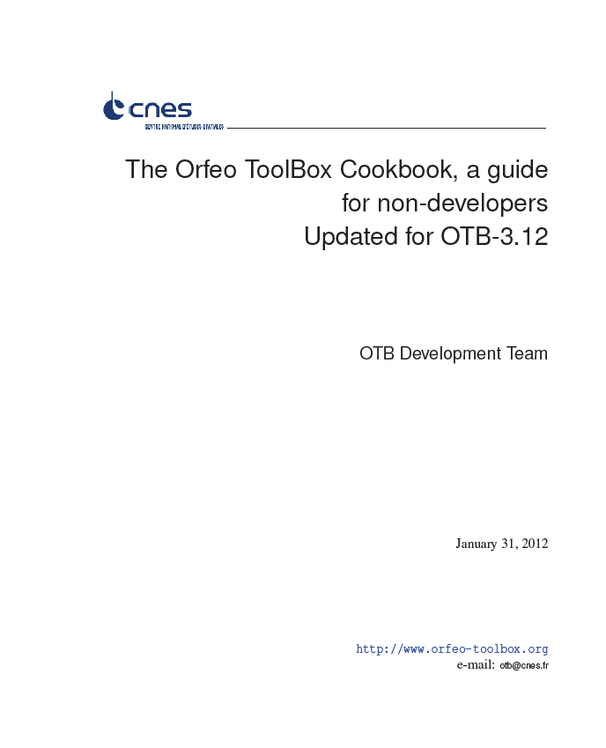
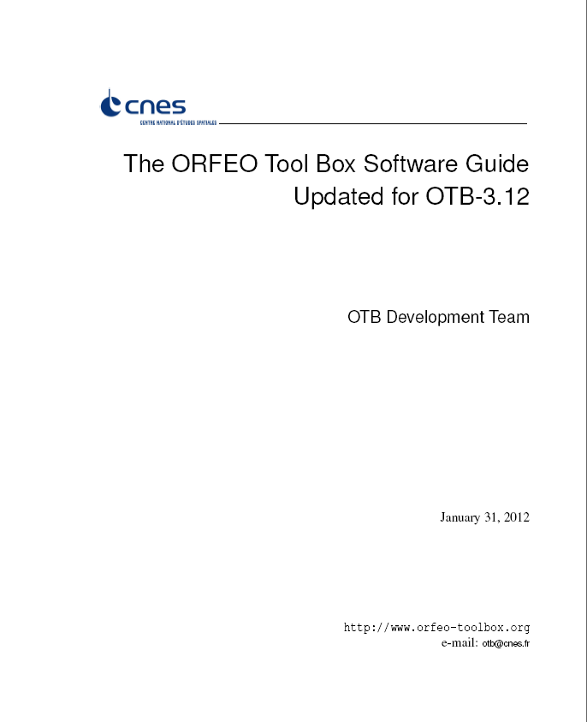
Orfeo ToolBox & Best practices: source code and documentation
Software guide [3]:
First steps (Installation, Hello world, etc.),
Lots of classes use examples,
Examples of image processing chain sorted by thematic,
Tutorials.
Doxygen [4]:
List of all OTB and ITK classes ,
Each class is described (what, how, which parameters and methods).
Cookbook [5]:
Presentation of OTB Applications
A brief tour of Monteverdi
Recipes for various remote sensing tasks
Applications reference documentation

Slide 19
Orfeo ToolBox & best practices: strong interaction with users
Mailing list for OTB users: otb-users@googlegroups.com
Developers and users can ask and answer questions,
Read daily by developers, more than a support, it is a place of exchange about your experience using OTB (bugs, evolutions, etc).
A blog: http://blog.orfeo-toolbox.org/
A wiki: http://wiki.orfeo-toolbox.org,
A bug tracker: http://bugs.orfeo-toolbox.org,
Free training course: OGRS2012, LTC2013, Summer school
Commercial training course: http://www.orfeo-toolbox.c-s.fr/
Meet the users: SS2 symposium, OGRS, Esa Live Planet conference, IGARSS

Slide 20
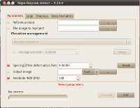

Orfeo ToolBox - OTB Applications framework
The Orfeo Toolbox (OTB) is a software library
First mission: provide building blocks to build applications in remote sensing image analysis
User targets: software developers with a good knowledge of C++
Need for a better accessibility : Using OTB features without a line of code
OTB Applications are a set of user tools for specific image processing tasks
Anyone can use OTB image processing algorithms
Less flexibility compared to writing your own program
Technical aspects:
A program (actually a shared library) providing a simple access to one or several functionalities of the toolbox.
The same application can be used in several ways
OTB Application
Framework
Application’s
functionalities
(shared library)
connects to
>_
Command line launcher
GUI launcher
Python package
provides

Slide 21
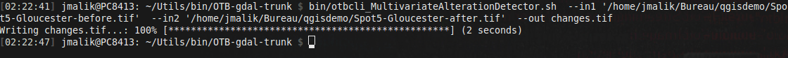
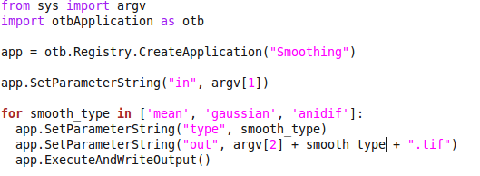
Orfeo ToolBox - OTB Applications framework
Application « modules » framework
Bundle simple or more complex pipelines to access OTB functionalities
Integrated documentation
Reuse in several contexts:
Command line
Python/Java

Slide 22
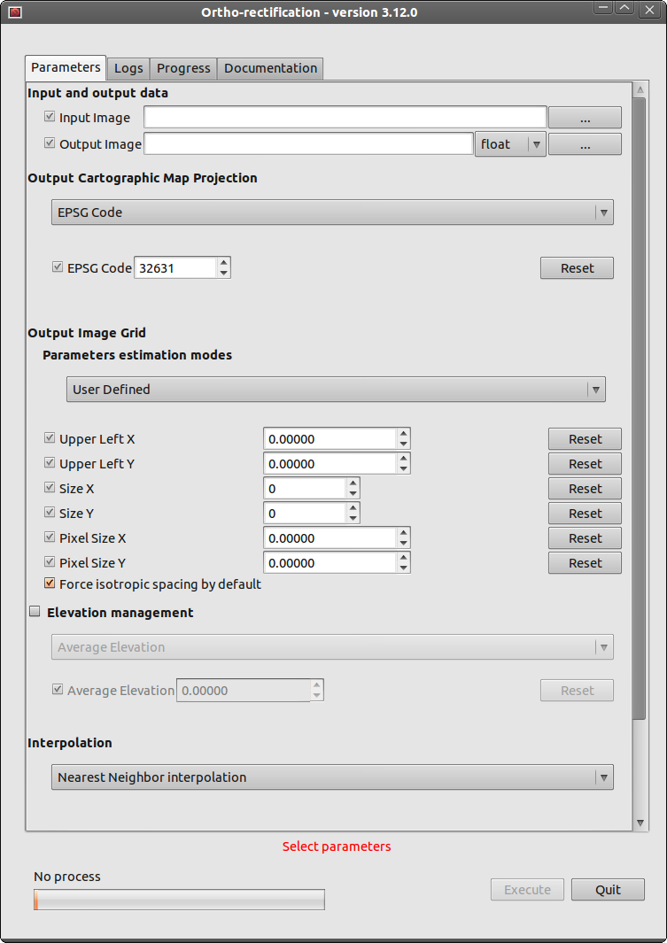
Orfeo ToolBox - OTB Applications framework
Reuse in several contexts:
Automatically generated GUI

Slide 23
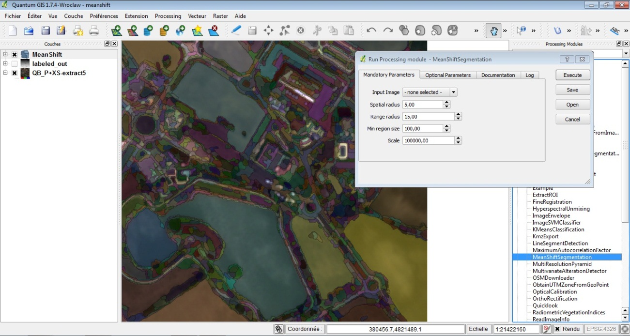
Orfeo ToolBox - OTB Applications framework
QGIS : an open-source GIS which grow
OTB as plugin in QGIS:
based on QGIS plug-in framework and SEXTANTE project

Slide 24
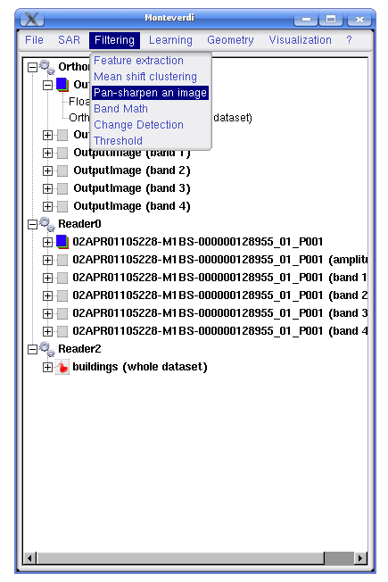
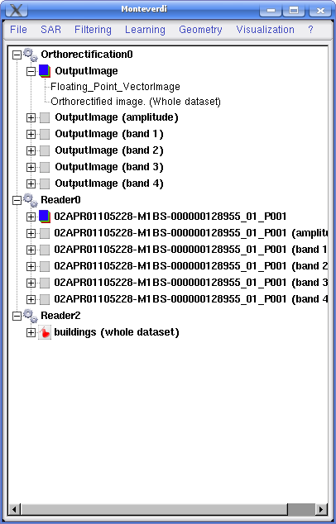
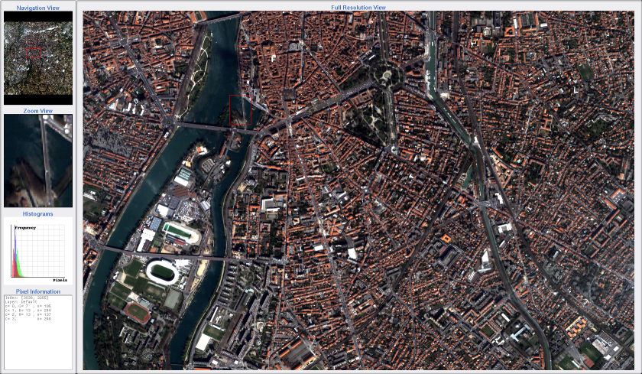
Orfeo ToolBox – Monteverdi: bringing OTB power to the end users
Monteverdi:
Export OTB functionnalities
modular

Slide 25
Orfeo ToolBox – Monteverdi: bringing OTB power to the end users
Geometry
Orthorectification,
reprojection of ortho-images
Superimpose two images
Filtering
Feature Extraction
Meanshift clustering
Pan-sharpen an image
Band math
Change detection
Threshold
Miscanlenious:
Classification, radiometric corrections, image comparison, …
Modular: adding new processing modules or executable is possible

Slide 26
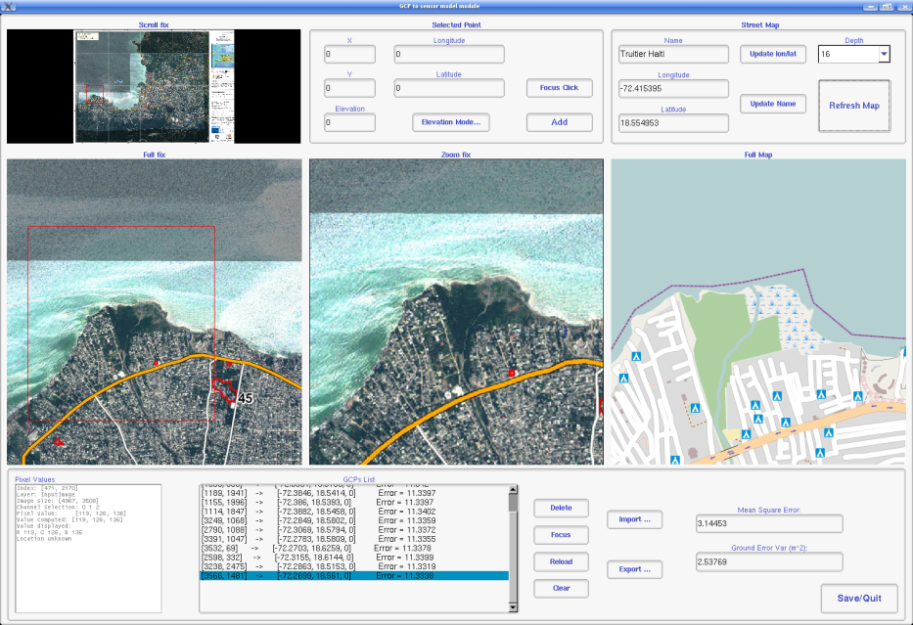
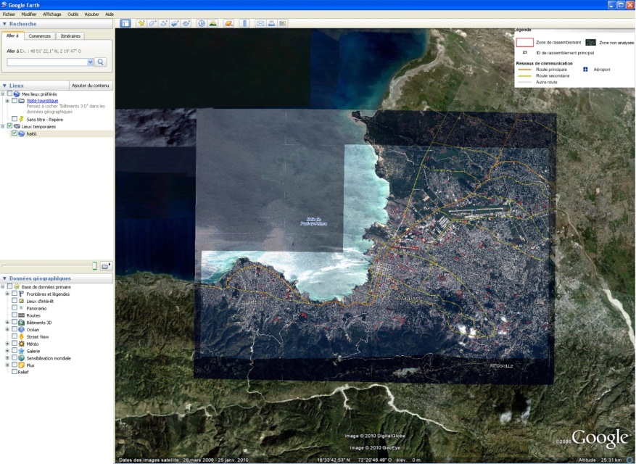
Orfeo ToolBox – Monteverdi: bringing OTB power to the end users
Export any product or processing result as KMZ for viewing in GoogleEarth
Register GCPs between a scene and Open Street Map data

Slide 27
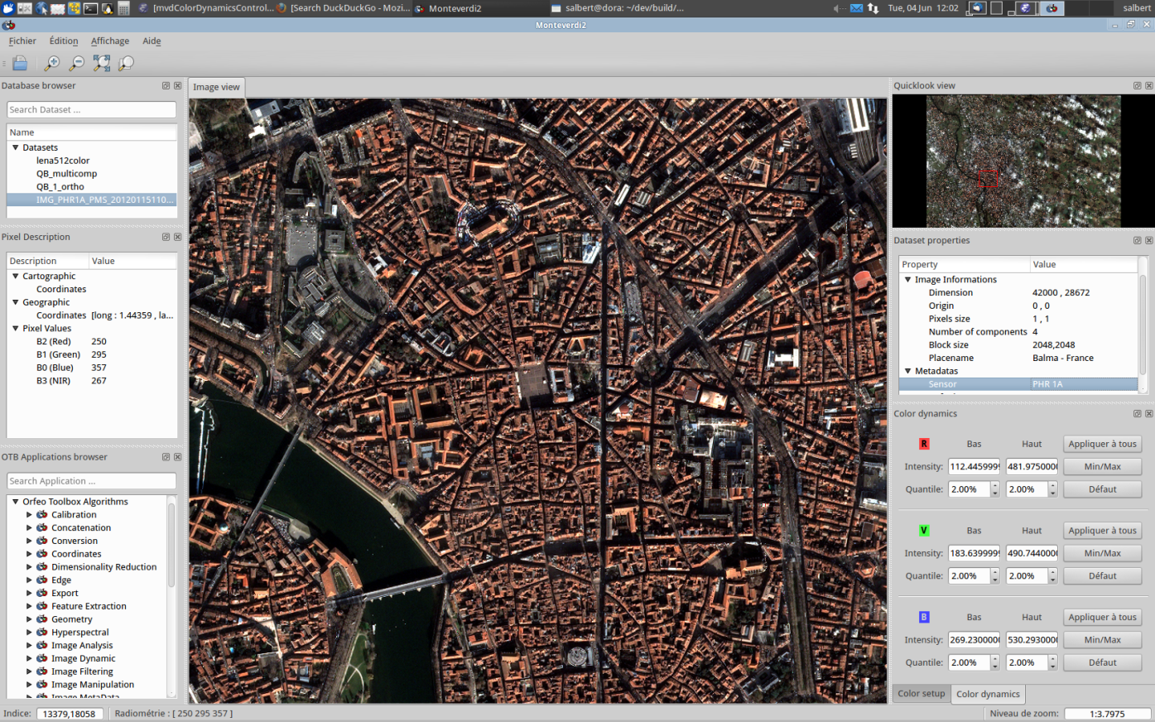
Orfeo ToolBox – Monteverdi 2.0
Next major version in 2013
Based on Qt framework to enhance user experience
Interconnect OTB application framework with a user friendly HMI
New visualisation tool
Based on product database
Native internationalisation
Test it, use it and send us your feedback and your analysis

Slide 28
OTB USE CASES
From research to operational context

Slide 29

Orfeo ToolBox – Venµs L2/L3 processing chain
Context: Vegetation and Environment monitoring on a New Micro-Satellite
Venµs mission: demonstrator for environment monitoring within GMES programme
Goal: Design and development of L2 and L3 processing chains
Aerosol LUT extraction
Clouds detection,
Atmospheric correction,
Shadow detection,
Estimation of effect environment
Use of OTB library to re-use possibility and huge data volume processing
OTB filters: statistics, basics filters, resampling, interpolators, reading and writing TIF/JPG/HDF images data and XML data, DTM reading, …
OTB framework: correlation, interpolation, composite filters, IO factories, …
Generic implementation of multi spectral camera capability: Formosat, Venµs, Landsat 5/7 (8), Sentinel-2, …

Slide 30
Orfeo ToolBox - Sentinel-2 processing
Multi-mission Atmospheric and Cloud Correction Software (MACCS)
Processing multi-temporal and/or multi-spectral images to produce physical measurements
Used in the Sentinel 2 ground segment prototype (SL2AP, Simplified Level-2A Processor)
Sentinel 2 Level-0 and Level-1 Instrument Processing Facility (IPF)
Automatic production of large volume of Sentinel-2 L1c products
OTB in IDP-SC development: cloud mask computing, resampling, radiometric corrections.
Merge OTB best practices and ESA requirements
Sentinel-2 Mission Performance Assessment (MPA)
Analysis module based on ORFEO ToolBox
Applications demonstrator project: PRO-Fusion (fusion of ProbaV and Sen-2)
OTB already participate to the Sentinel-2 adventure

Slide 31







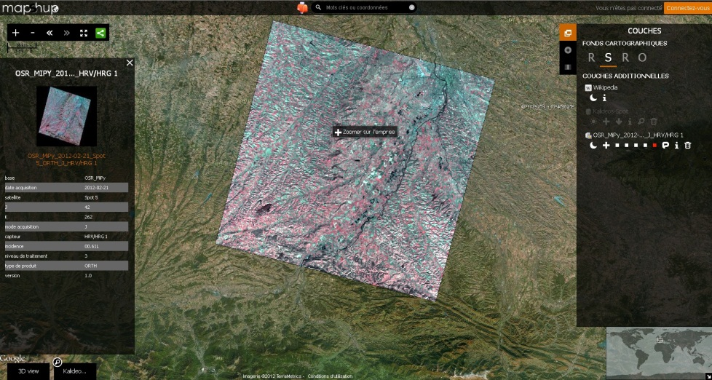

Orfeo ToolBox - Plateforme Aval Pleiades: OTB and Web Services
Use OTB to extract information from Pleiades product used by ORFEO community
Generate data for product database (ingestion, radiometric calibration, …)
Online processing based on WPS and OTB functionalities (stereo, segmentation, …).
Processing
server
Client
SDI

Slide 32
Orfeo ToolBox – Various projects
ESA-KEO: integrate OTB into a modular/scalable Component-based Processing Environment
CNES-PEPS: online processing based on OTB for French administration
OTB and Education: learn remote sensing at school (Qgis Plugin and simple IHM)
SYRHIUS: continental water quality management with EO data and OTB
2 external front-end applications Gnorasis and Mustic software
UNESCO World Heritage site monitoring[9]
MAISEO: include OTB processing chain to monitor agricultural practices
CNES-Kalideos: land-cover processing based on OTB
SATERRE: online processing based on OTB for agriculture management
PTSC/GEOSUD: French initiative to organize skills around EO processing
TPZ-EARTHLAB: regional initiative to offer remote sensing service to end-users
ESA-TIGER: Forest monitoring based on EO data
IRD-FOTO_METRICS: estimation of forest biomass based on textural analysis wit OTB
More and more uses cases

Slide 33
CONCLUSION
OTB has strong assets to be used as a development framework for image processing of big data volumes
Flexible: open source, bindings (java, python)…
Completeness: many algorithms available
Performance
Maintainability: documentation, strong development rules, …
OTB a robust development framework and
Compatible with several contexts and use-cases
OTB-Monteverdi a modular visualization and execution tool
Bring to end-users the best of the library and the possibility to visualize EO products
Merge thematic issues and image processing solutions
Offer a tool to simplify the prototype validation
Share state of art of image processing solution in an open-source tool
Address more and more issues to enhance OTB ecosystem

Slide 34
Bibliography
[1] TINEL, C., FONTANNAZ, D., DE BOISSEZON, H., GRIZONNET, M., AND MICHEL, J. The orfeo accompaniment program and orfeo toolbox; IGARSS 2012
[2] INGLADA, J., AND CHRISTOPHE, E. The orfeo toolbox remote sensing image processing software; IGARSS 2009.
[3] Software guide: http://www.orfeo-toolbox.org/SoftwareGuide
[4] Doxygen: http://www.orfeo-toolbox.org/doxygen/classes.html
[5] Cookbook: http://www.orfeo-toolbox.org/CookBook
[6] TOLOMEO: http://tolomeofp7.unipv.it/
[7] BIOSOS: http://www.wageningenur.nl/en/Expertise-Services/Research-Institutes/alterra/Projects/BIO_SOS.htm
[8] OTB team, Open tools and methods for large scale segmentation of Very High Resolution satellite images, OGRS 2012
[9] http://www.congrexprojects.com/docs/12c04_doc/4-sentinel2_symposium_radoux.pdf?sfvrsn=2

